Slide 1


Slide 2

Software Development life Cycle Airline Reservation System
Designed and Developed
By
SHEHRYAR AZIZ (MCSM-F21-021)& Raja IJAZ
SUPERIOR UNIVERSITY LAHORE GOLD CAMPUS
Supervised
By
DR.MOMMAL QURESHI
Department of CS/IT

Slide 3
Abstract
Airline Reservation System is a computerized system, that contains the details about flight schedules, passenger reservations and ticket record. An airline’s inventory contains all flights with their available seats.

Slide 4
Requirement Analysis
Since this is semester project and not a commercial project there for requirements of the projects were simple.
Following were the requirements:
Local / International Booking.
Searching of Flights.
Airline Selection.
Getting Passenger Data.
Airline Class Selection.
Time Selection.
Displaying of Ticket.
Saving Ticket in a File.
Exit from the system.

Slide 5
Requirement Analysis
In developing the whole software, the four basic pillars of object oriented programming were kept in view:
Data Hiding
Encapsulation
Inheritance
Polymorphism

Slide 6
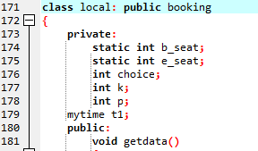
Encapsulation
It describes the idea of bundling data members and methods that work on that data within one unit, e.g., a class in C++.

Slide 7
Data Hiding
Data hiding is a software development technique specifically used in object-oriented programming (OOP) to hide internal object details (data members) from other classes.

Slide 8

Inheritance
Inheritance is the mechanism of basing an object or class upon another object or class, retaining similar implementation. Just Like a parent child Relation.

Slide 9

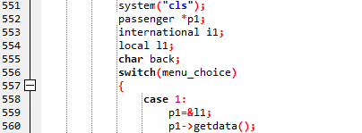
Polymorphism
Polymorphism refers to a ability to process objects differently depending on their data type or class.

Slide 10


Composition
It describes a class that references one or more objects of other classes in instance variables.

Slide 11
Design
Class Diagram

Slide 12
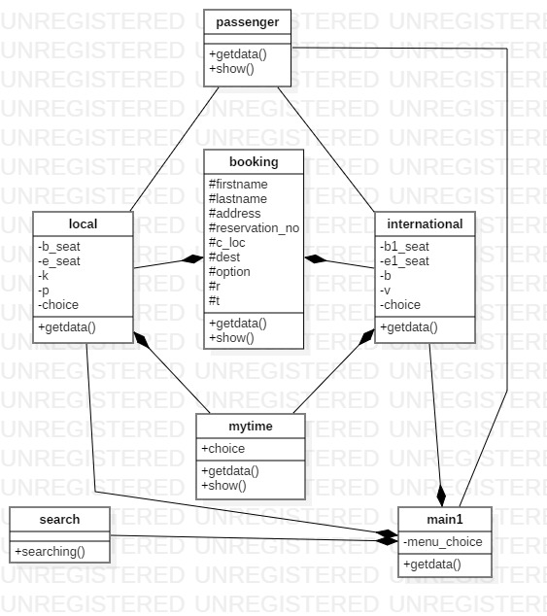

Slide 13
Implementation
Program Code:

Slide 14
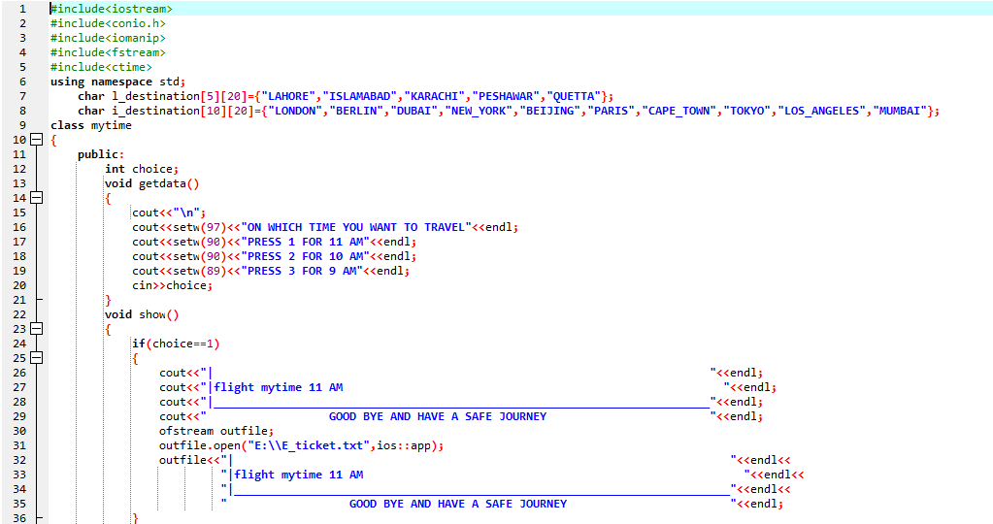

Slide 15
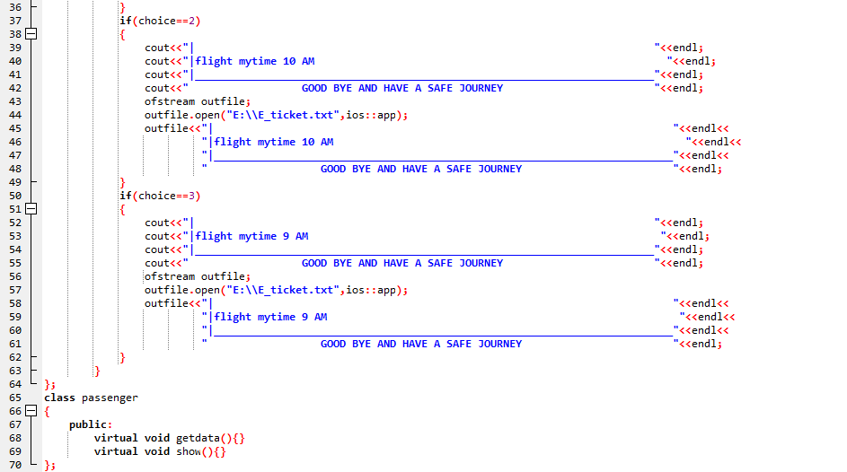

Slide 16
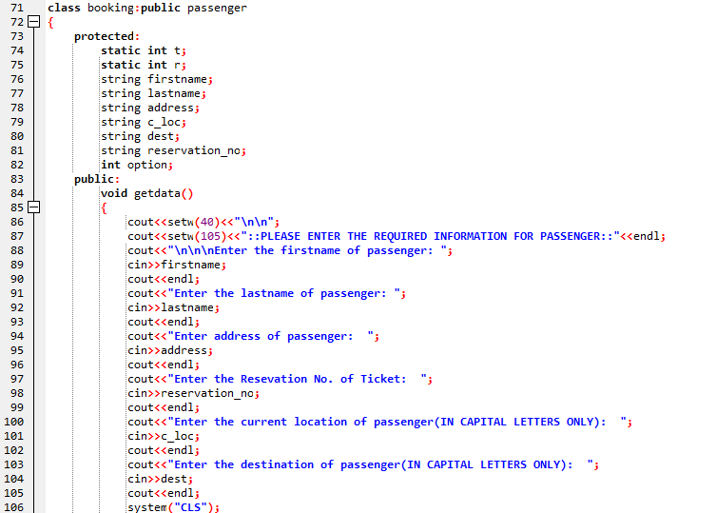

Slide 17
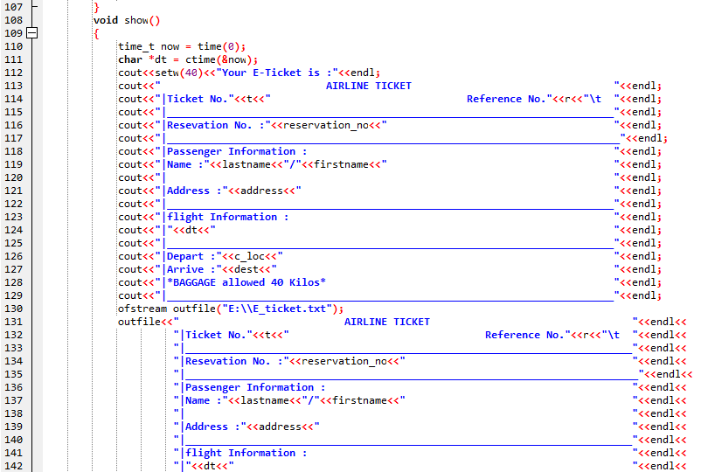

Slide 18
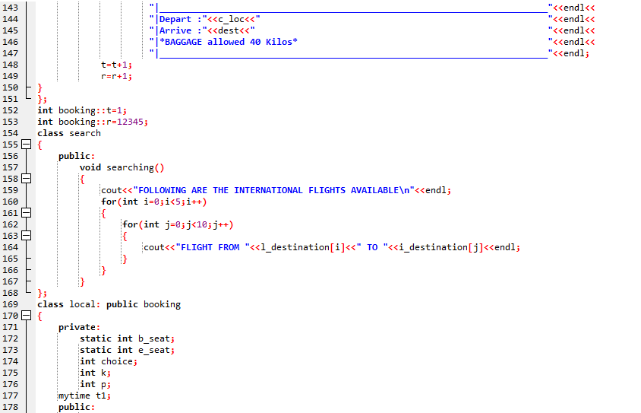

Slide 19
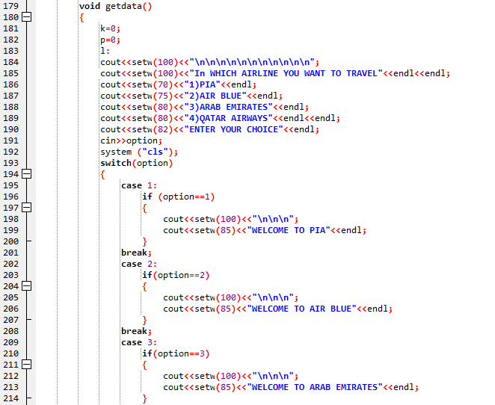

Slide 20
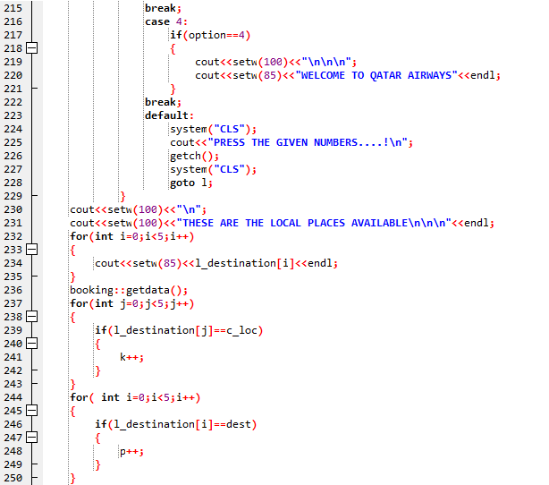

Slide 21
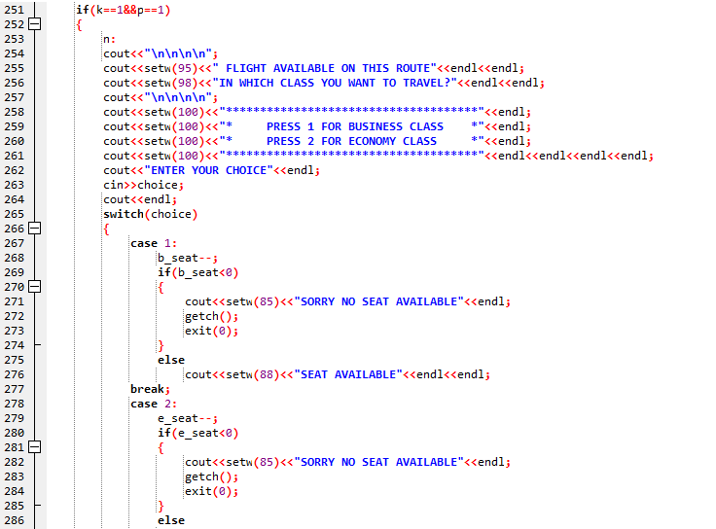

Slide 22
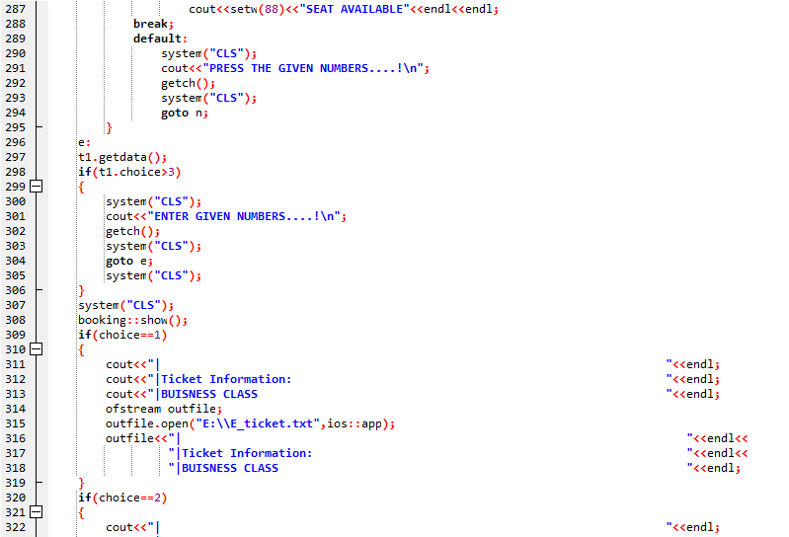

Slide 23
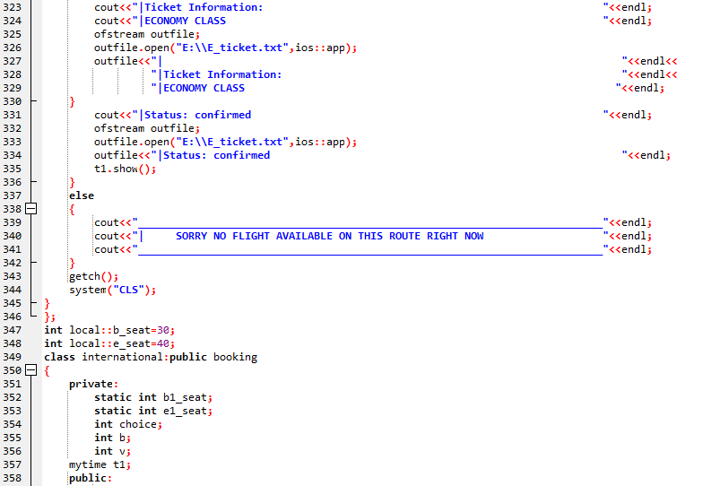

Slide 24
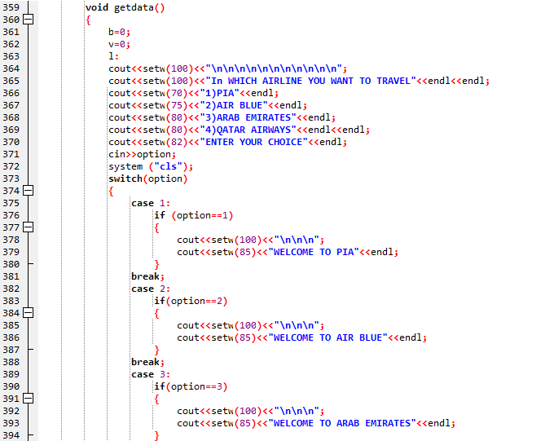

Slide 25
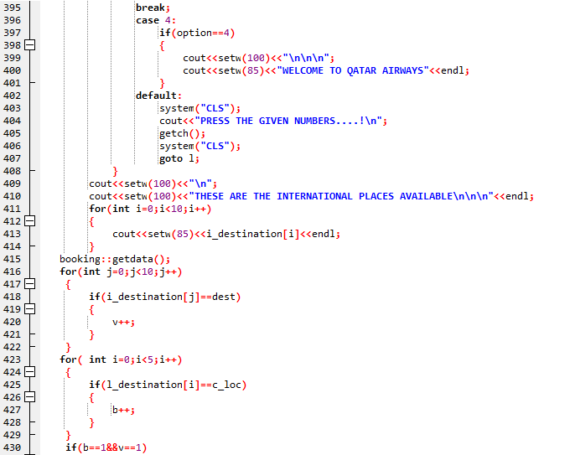

Slide 26
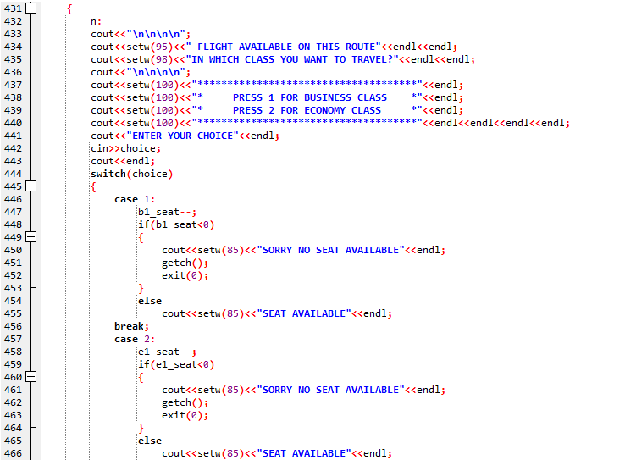

Slide 27
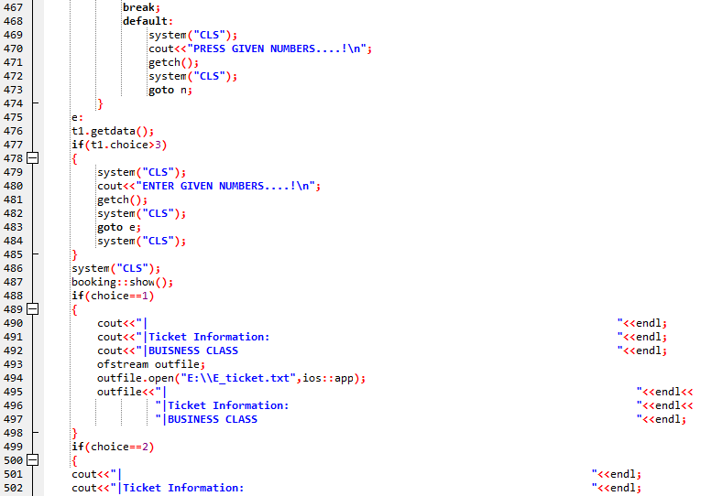

Slide 28
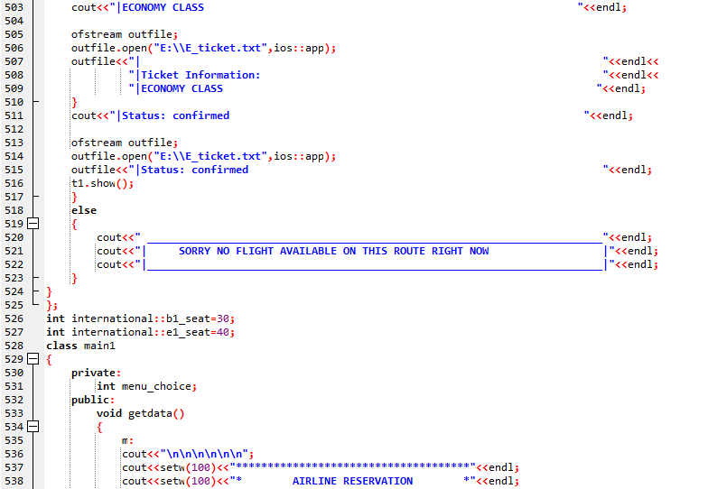

Slide 29
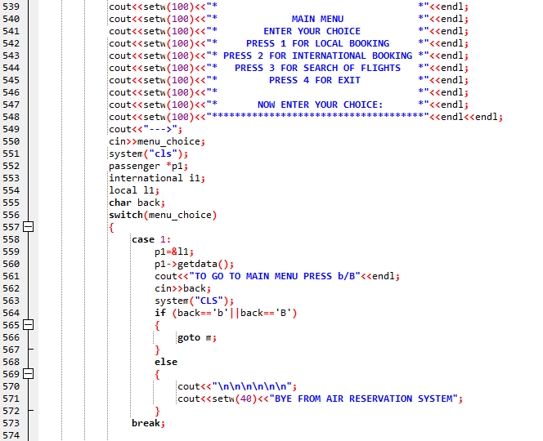

Slide 30
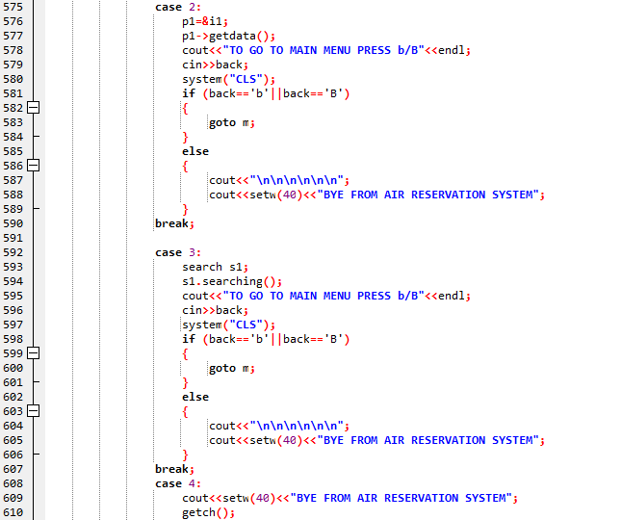

Slide 31
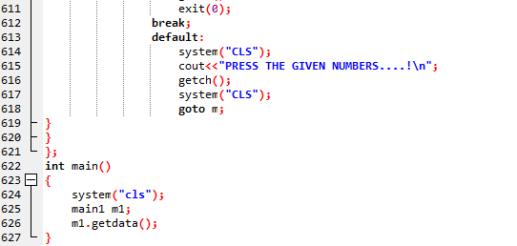

Slide 32
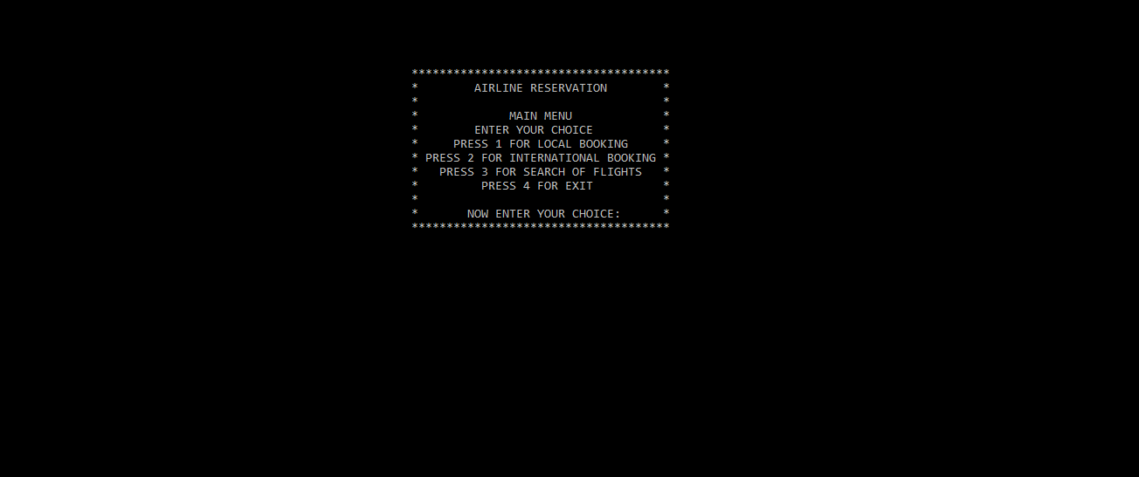
Output

Slide 33
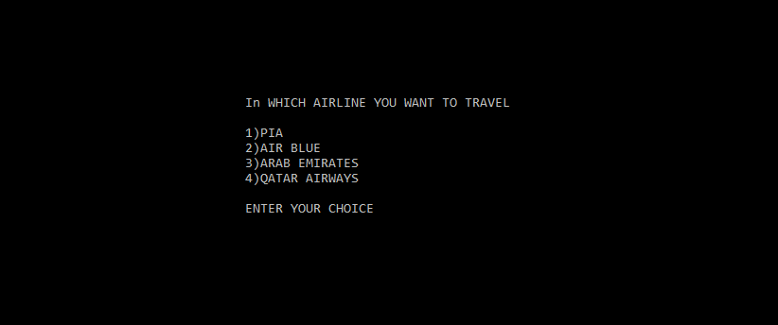

Slide 34
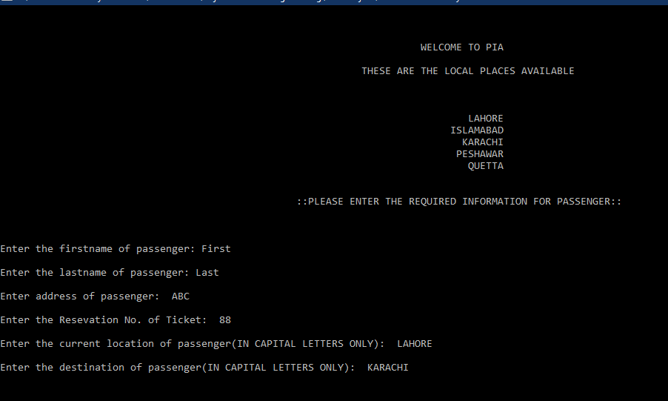

Slide 35
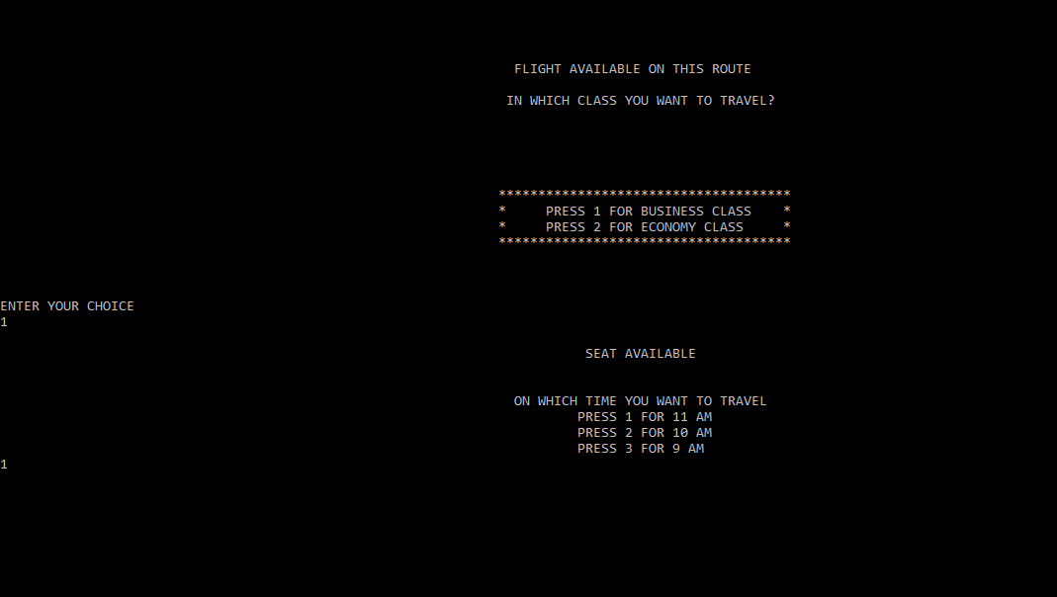

Slide 36
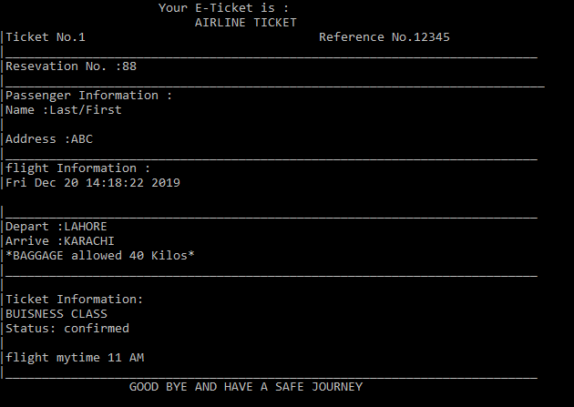

Slide 37
Testing
Testing phase is carried out by calling the following classes in the main function.
Local
For The Booking of Local Flights.
International
For the Booking of International Flights.
Booking
Getting Passenger Data.
Ticket
To ensure the display of ticket and formation of file for ticket.

Slide 38
Deployment
The software has been deployed on a stand alone Computer as it is a semester project and not a commercial project. Therefore web base version has not been deployed only desktop version is deployed for university record. This version is efficient and robust.

Slide 39
Maintenance and Upgradation
Maintenance and up gradation is an ongoing process therefore it will be maintained and upgraded by future students.

